Slide 1
CS460 Vision for Graphics Instructor: Craig Yu

Slide 2
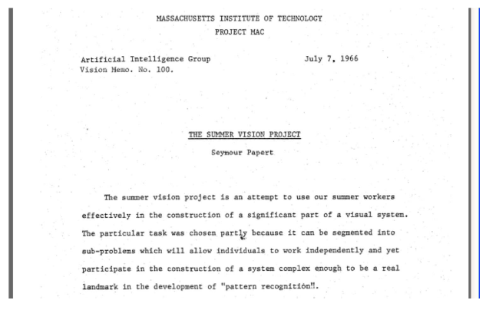
What is Computer Vision ?
In 1966, Marvin Minsky at MIT asked his undergraduate student Gerald Jay Sussman to “spend the summer linking a camera to a computer and getting the computer to describe what it saw”
“In the 1960s, almost no one realized that machine vision was difficult.” – David Marr, 1982
40+ years later, we are still working on this…

Slide 3
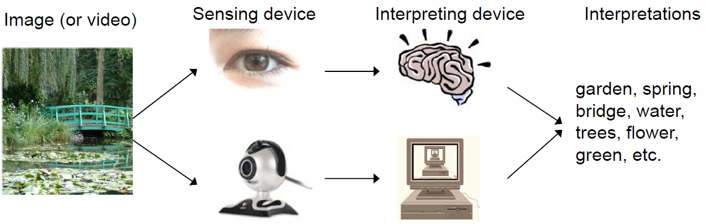
What is Computer Vision ?

Slide 4
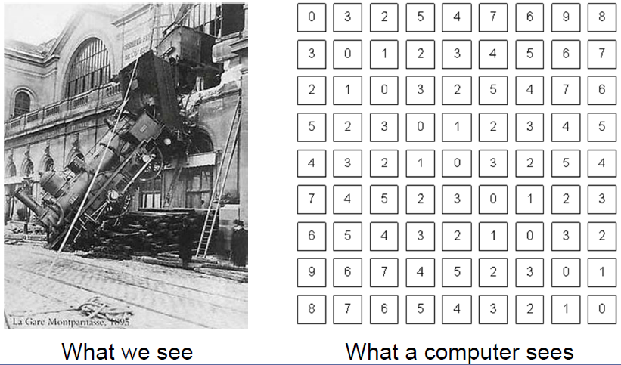
The goal of computer vision
To bridge the gap between pixels and “meaning”

Slide 5
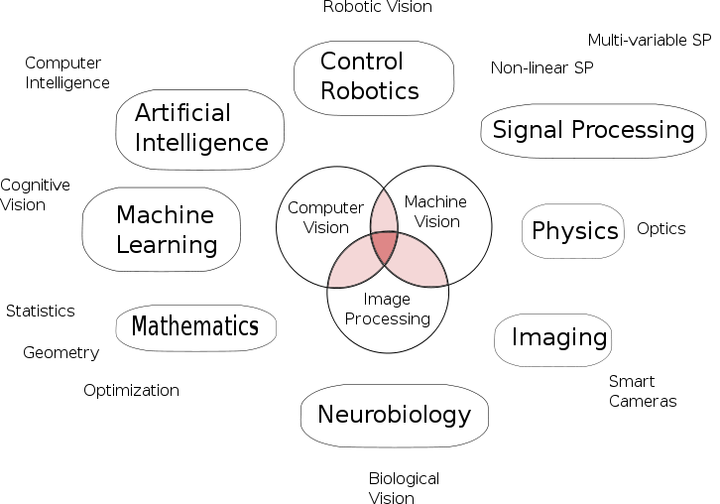
What is Computer Vision ?
From Wikipedia

Slide 6
What is Computer Vision ?
Computer Vision
Stereo,
3D Reconstruction, etc.
Image Processing
Computer Graphics
Image Enhancement,
Denoising, etc.
Rendering,
3D Modelling, etc.

Slide 7
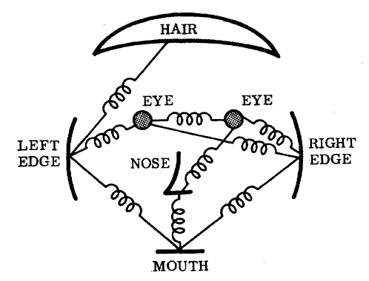
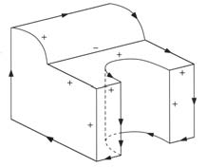
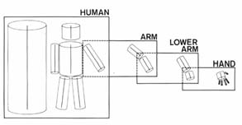

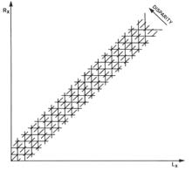
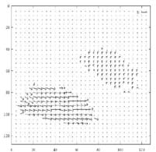
1970s
line labeling
pictorial structures
articulated body model
intrinsic images
stereo correspondence
optical flow

Slide 8
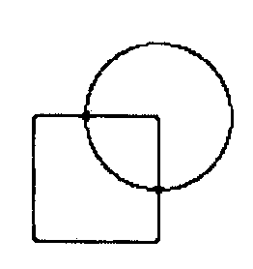
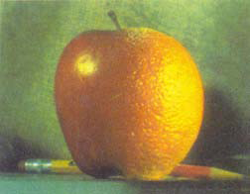
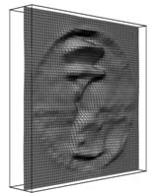
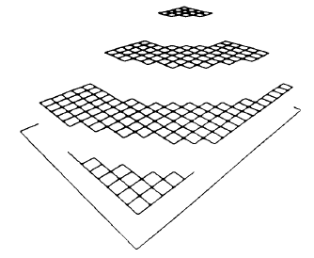
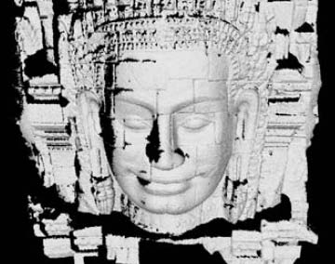
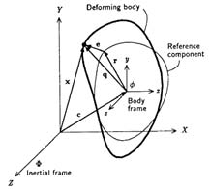
1980s
pyramid blending
shape from shading
edge detection
physically-based models
regularization-based surface reconstruction
range data acquisition and merging

Slide 9
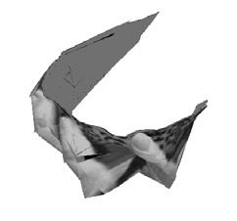


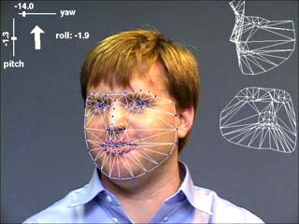

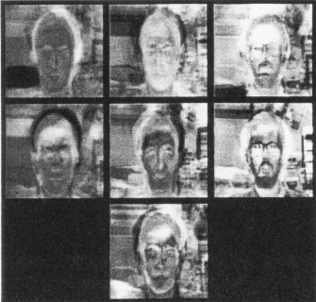
1990s
factorization-based structure from motion
multi-view reconstruction
dense stereo matching
face tracking
image segmentation
face recognition

Slide 10
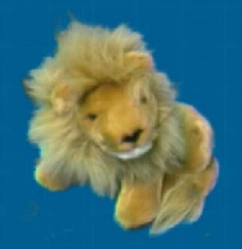
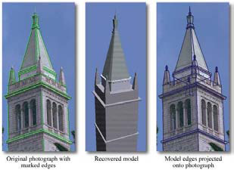
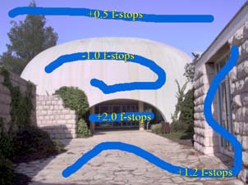

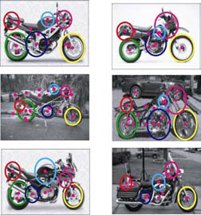
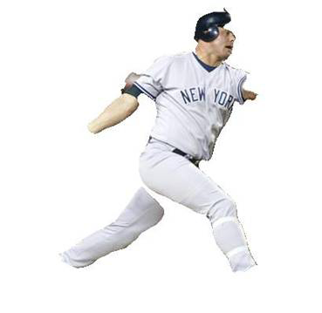
2000s
image-based rendering
image-based modeling
Interactive Techniques
texture synthesis
feature-based recognition
region-based recognition

Slide 11
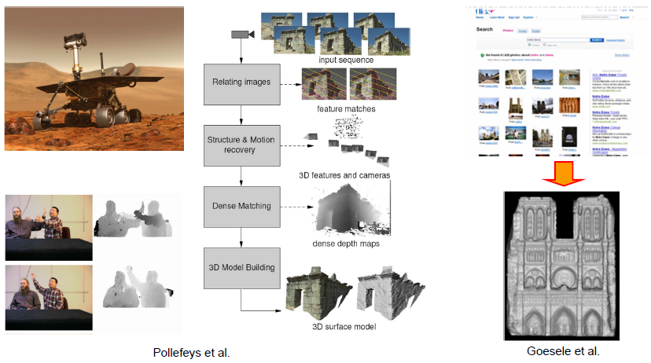
State-of-the-art ?
http://www.xbox.com/en-US/kinect

Slide 12
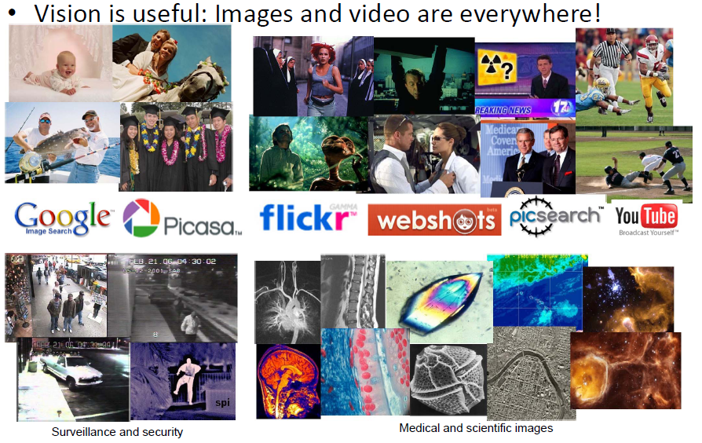
Why study computer vision ?

Slide 13
Why study computer vision ?
Vision is useful
Vision is interesting
Vision is difficult
Half of primate cerebral cortex is devoted to visual processing
Achieving human‐level visual perception is probably “AI‐complete”

Slide 14
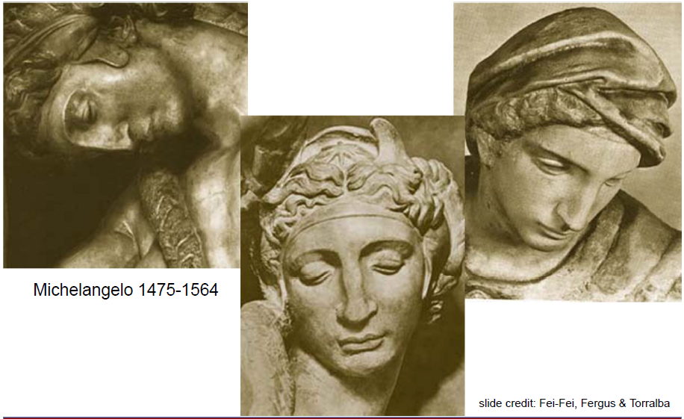
Challenges: viewpoint variation

Slide 15
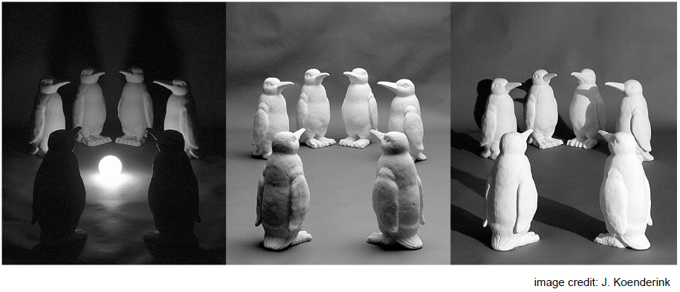
Challenges: Illumination

Slide 16
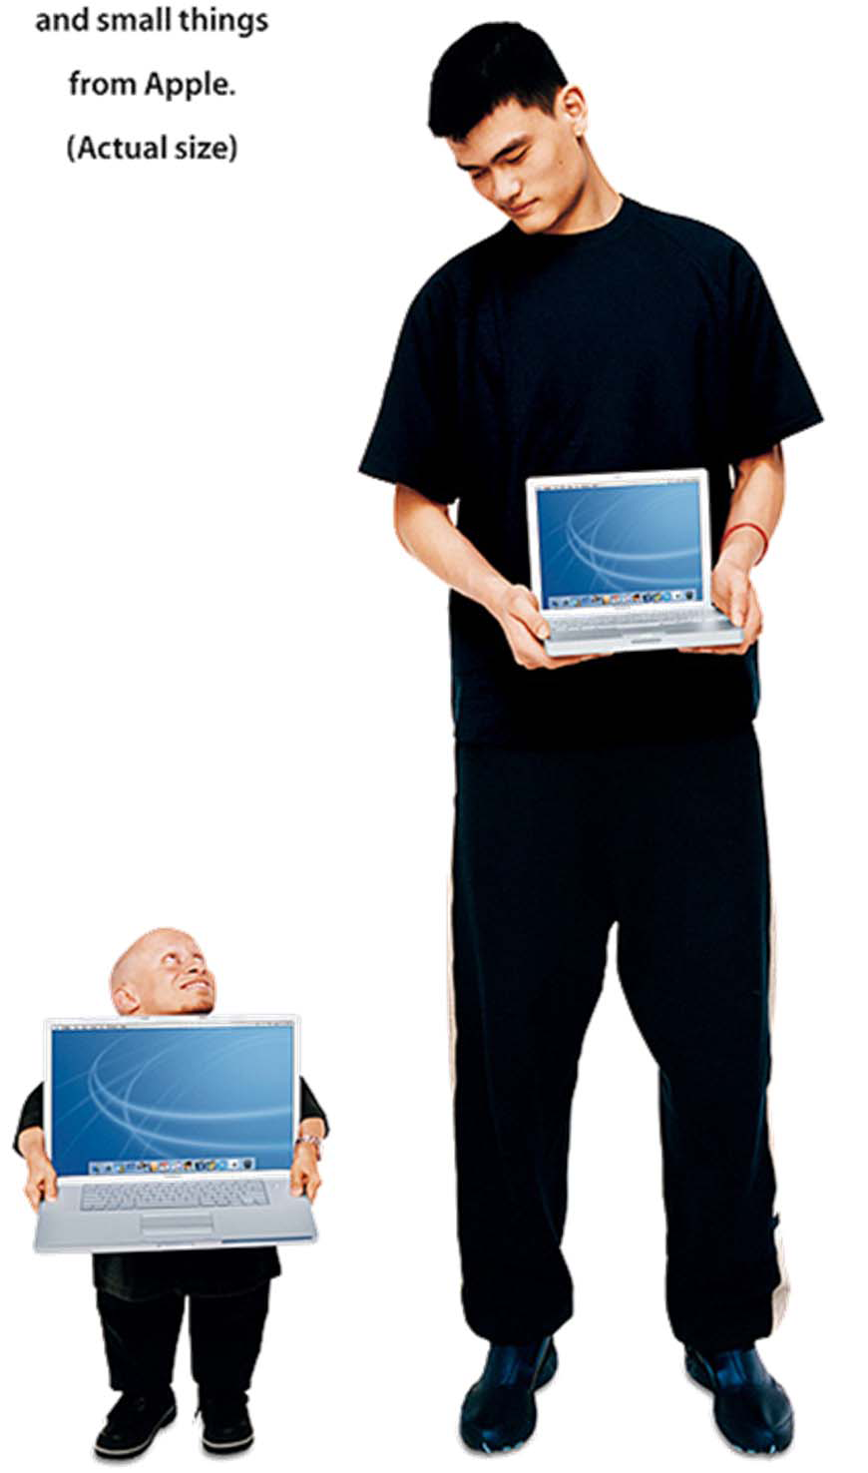
Challenges: Scale

Slide 17
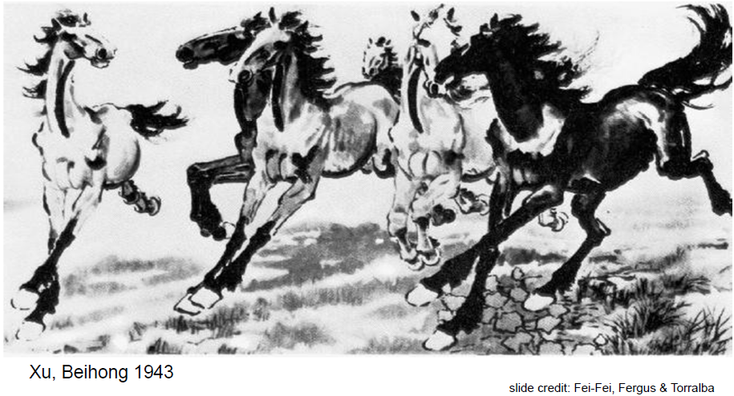
Challenges: Deformation

Slide 18
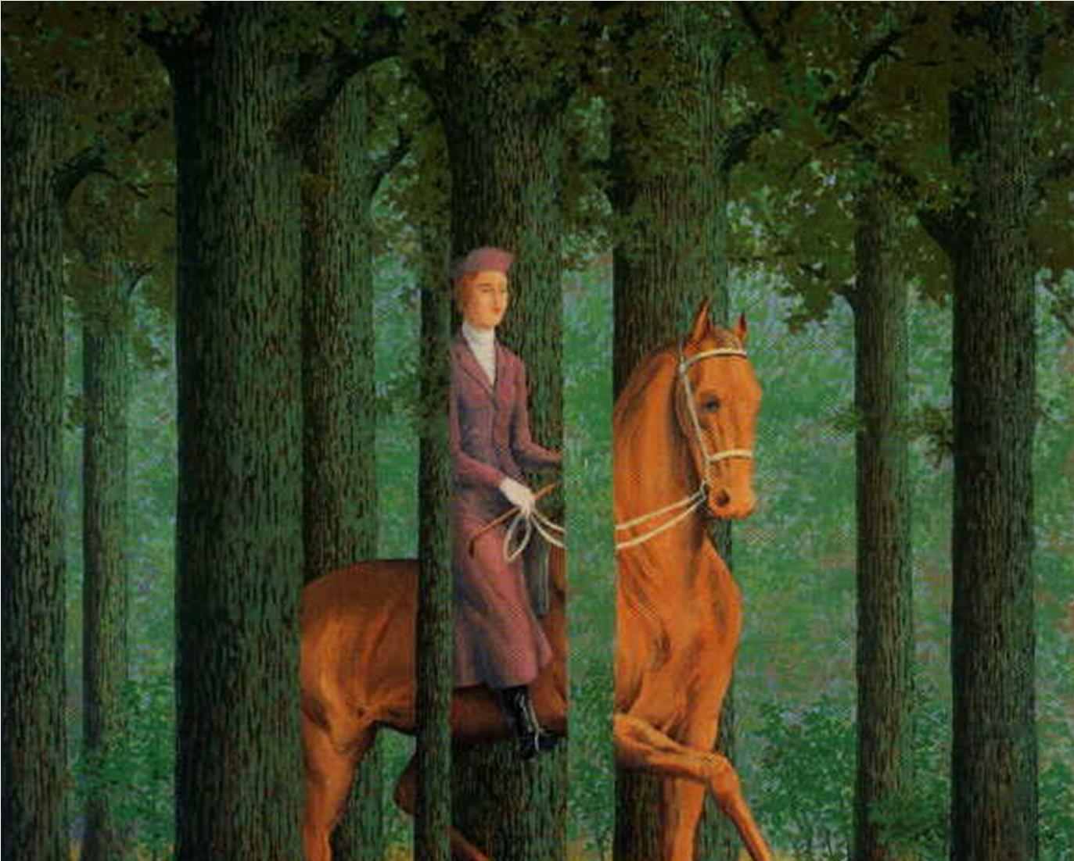

Challenges: Occlusion

Slide 19
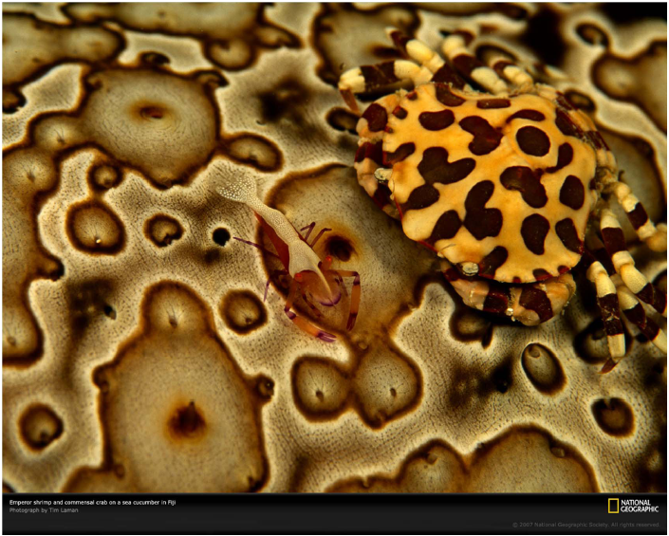
Challenges: Background cluster

Slide 20

Challenges: Motion

Slide 21

Challenges: Object intra-class variation

Slide 22
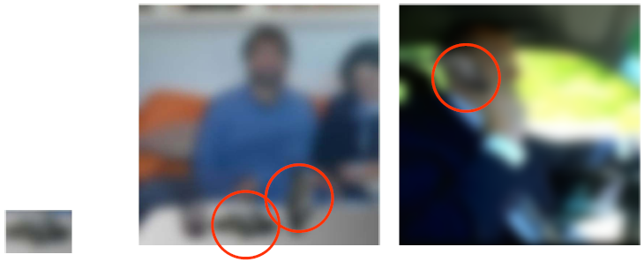
Challenges: Local Ambiguities

Slide 23
Challenges or opportunities?
Images are confusing, but they also reveal the structure of the world through numerous cues
Our job is to interpret the cues!

Slide 24
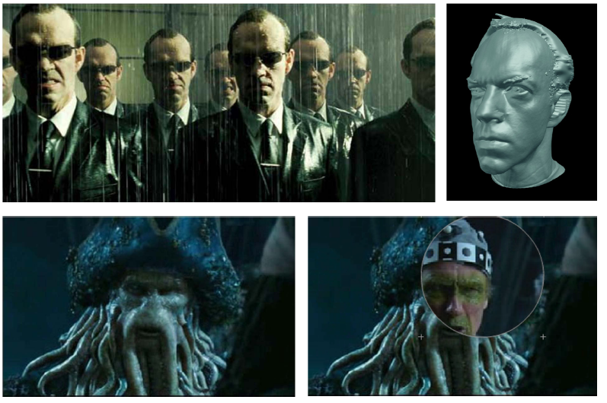
Computer Vision in the Real World
Special Effects in movie

Slide 25
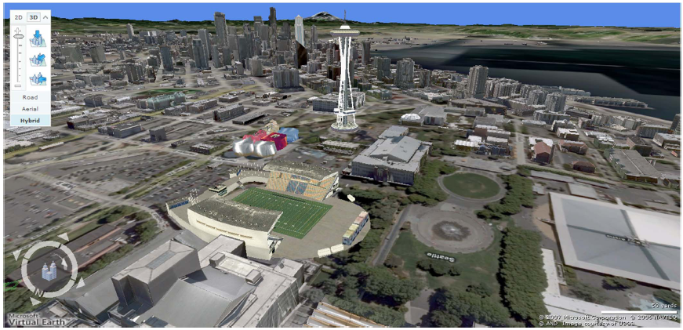
Computer Vision in the Real World
3D Urban Modeling

Slide 26
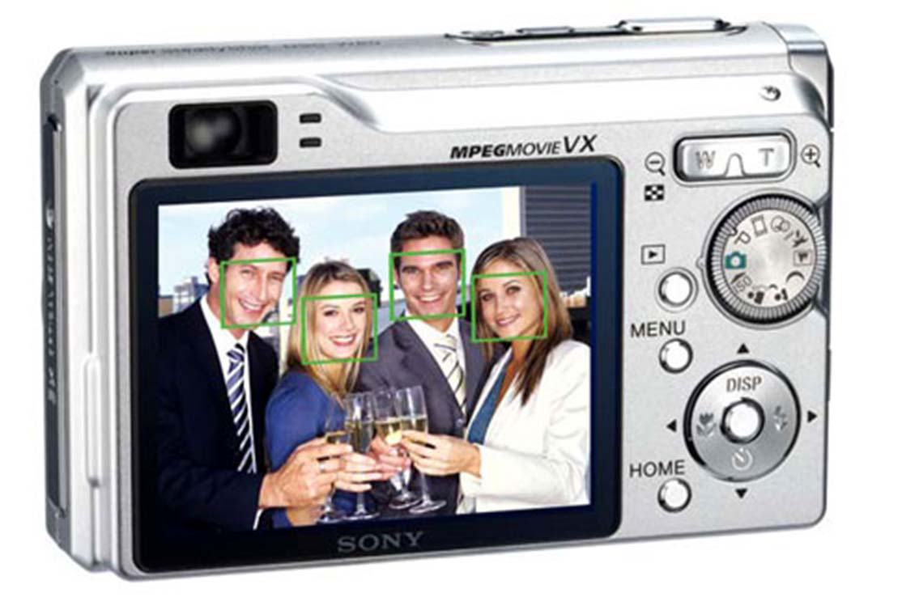
Computer Vision in the Real World
Face Detection

Slide 27
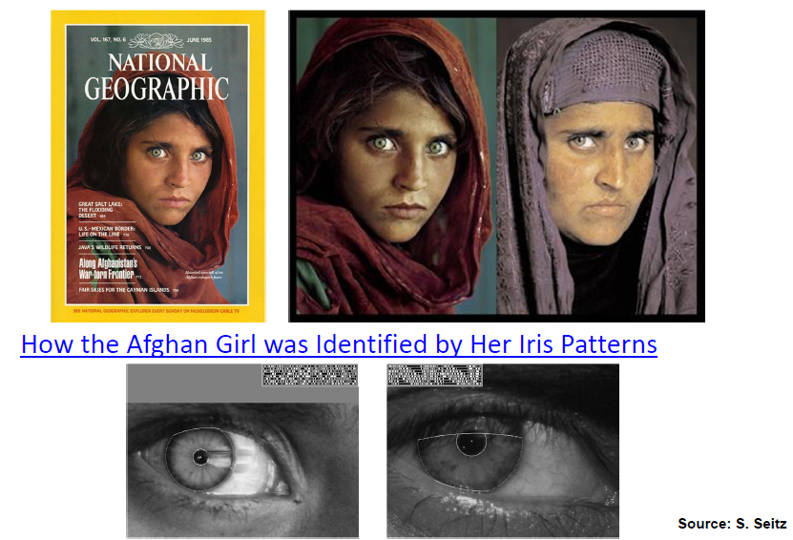
Computer Vision in the Real World
Biometrics

Slide 28
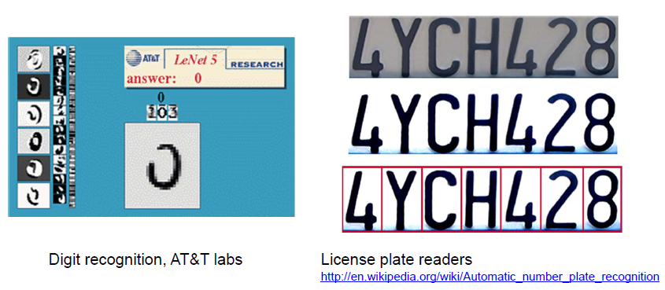
Computer Vision in the Real World
Optical Character Recognition (OCR)

Slide 29
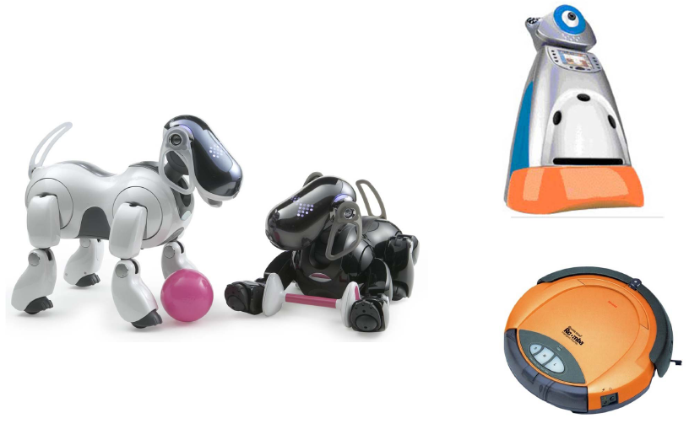
Computer Vision in the Real World
Toys and Robots

Slide 30
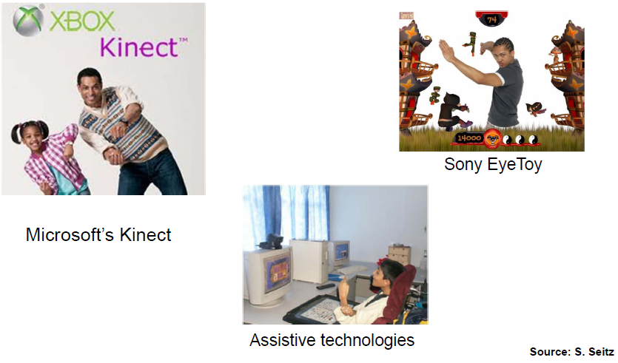
Computer Vision in the Real World
Games

Slide 31
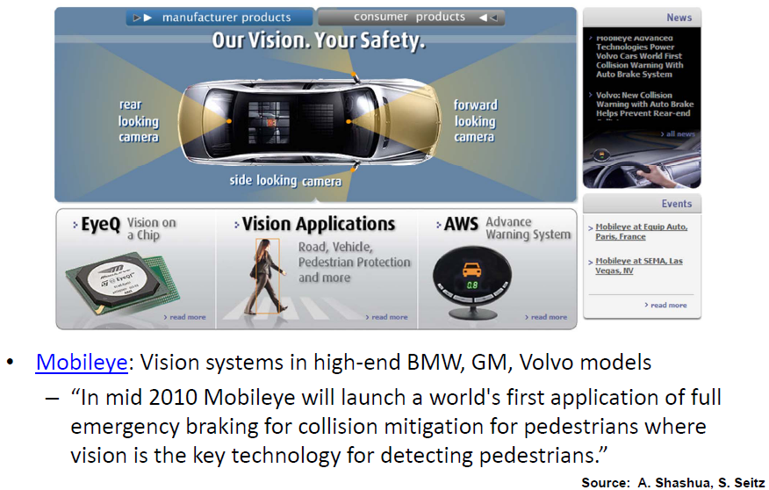
Computer Vision in the Real World
Automotive Safety

Slide 32
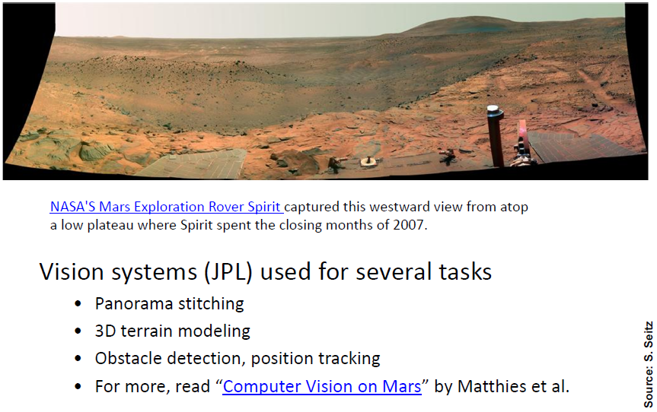
Computer Vision in the Real World
Vision for robotics, space exploration

